Slide 1
Introduction to Cybersecurity

Slide 2
Agenda
What is Cybersecurity?
Is Cybersecurity an Onion?
What is CIA?
What are the First 10 Principles (F10P) of Cybersecurity?

Slide 3
Learning Objectives
Describe the purpose of Cyber Security
Explain the multiple layers of Cyber Security
Describe the principles of CIA
Explain the concepts of Cybersecurity First 10 Principles

Slide 4


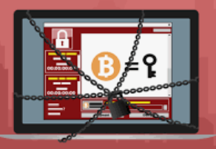
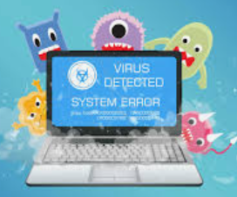
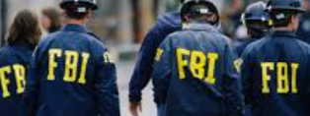
What is Cybersecurity?

Slide 5









Why is Cybersecurity important?

Slide 6

Is Cybersecurity an Onion?

Slide 7
The Onion
Networks
TCPIP UDP
Routers Switches
Operating Systems
Windows
Linux
Applications
Database
Email
Social Media

Slide 8
Detection Influencers
Risks – potential loss/harm related to technical infrastructure, use of technology or reputation of an organization
Vulnerabilities – a weakness which can be exploited by a threat actor to perform unauthorized actions within a computer system
Attacks – SQL Injection, DNS Tunneling, MITM, DOS, Phishing
Security Onion
Risks
Vulnerabilities
Attacks

Slide 9
Prevention Influencers
Regulations – directives that safeguard computer systems with the purpose of forcing companies and organizations to protect their systems and information from cyberattacks
Policies – informs company users of their obligatory requirements for protecting the technology and information assets of the company
Best Practices – NIST CSF, OWASP, ISO 27001, CSC, FAIR, etc
Security Onion
Regulations
Policies
Best Practices

Slide 10
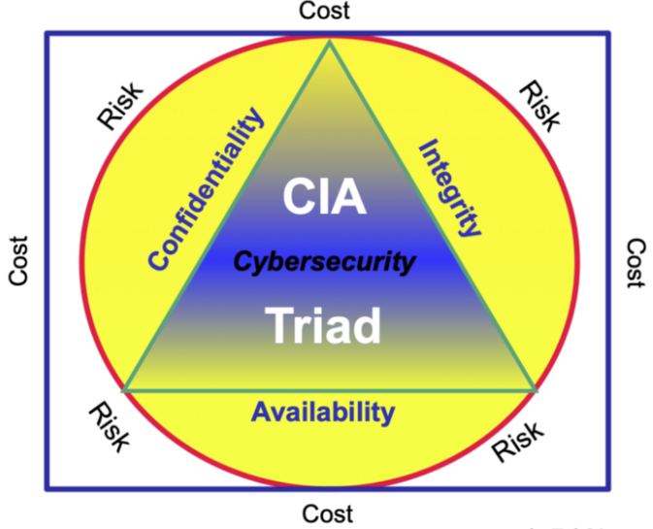
Cybersecurity CIA Triad

